Slide 1





Website for Vendor PPH Deduction Proof
PROJECT CHARTER – OCTOBER 2023

Slide 2

Table of Contents
Project Background and Current Situation
2. Project Objective and Key Result
3. Project Scope
4. Business Process Flow
5. Project Deliverables
6. Project Schedule
7. Project Organization

Slide 3
Project Background
Project Background
Setiap bulan, Departmen Tax mengirimkan bukti potong PPh ke vendor secara manual melalui email.
Jumlah vendor dan bukti potong nya cukup banyak, sehingga proses ini membutuhkan banyak waktu.
Sering kali, vendor menanyakan kembali perihal bukti potong PPh yang telah dikirimkan oleh Department Tax.
Hal ini membuat Department Tax harus bekerja dua kali karena perlu melakukan pencarian dan pengiriman ulang terhadap file bukti potong PPh yang diminta vendor.
Current Situation
Department Tax melakukan pelaporan PPh ke website DJP Online dan mengunduh bukti potong PPh dalam bentuk PDF, kemudian mengirimkan bukti potong secara manual by email sesuai dengan permintaan vendor.

Slide 4
Table of Contents
Project Background and Current Situation
2. Project Objective and Key Result
3. Project Scope
4. Business Process Flow
5. Project Deliverables
6. Project Schedule
7. Project Organization

Slide 5
Project Objective
Objective
Membuat website bukti potong PPh vendor untuk company TRIAS, TTA, TTE, dan UNS.
Key Result
Department Tax dapat mengunggah dokumen bukti potong PPh ke website.
Vendor dapat mengunduh secara mandiri dokumen bukti potong PPh yang diunggah ke website.
Department Tax tidak perlu mengirimkan dokumen bukti potong PPh secara manual melalui email kepada vendor.

Slide 6
Table of Contents
Project Background and Current Situation
2. Project Objective and Key Result
3. Project Scope
4. Business Process Flow
5. Project Deliverables
6. Project Schedule
7. Project Organization

Slide 7



Project Scope
Company
PT Trias Sentosa, Tbk.
PT Trias Toyobo Astria
PT Toyobo Trias Ecosyar
PT Unggul Niaga Sentosa
File Type and Size
PDF File Type
File Size (per document) less than 500Kb
Expired Date
One year from first time uploaded

Slide 8
Table of Contents
Project Background and Current Situation
2. Project Objective and Key Result
3. Project Scope
4. Business Process Flow
5. Project Deliverables
6. Project Schedule
7. Project Organization

Slide 9
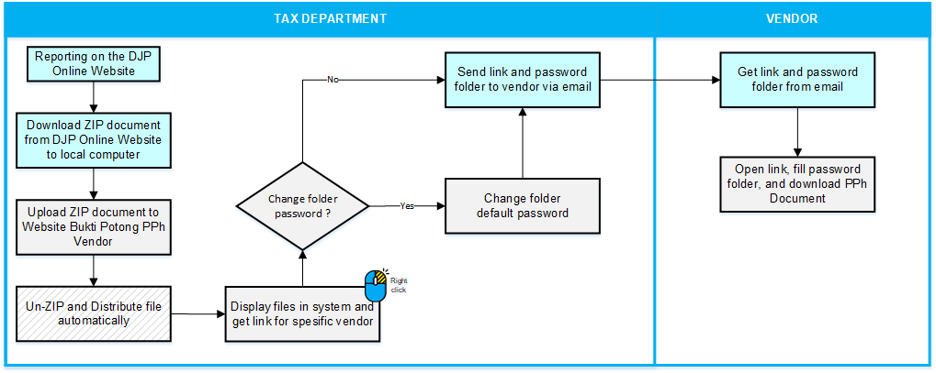

Business Process Flow
Scenario : Share Link Folder
Legend:
Flow to Next Step
Business Process in Website for Vendor PPH Deduction Proof
By Pass
Business Process in Other System (email, phone, etc.)
Background Process
Notes:
Tambah mockup kasaran dulu

Slide 10
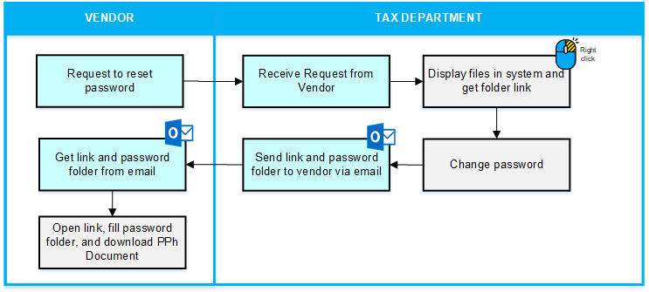
Business Process Flow
Scenario : Reset Folder Password
Legend:
Flow to Next Step
Business Process in Website for Vendor PPH Deduction Proof
By Pass
Business Process in Other System (email, phone, etc.)
Background Process
Notes:
Kolom vendor di kiri

Slide 11
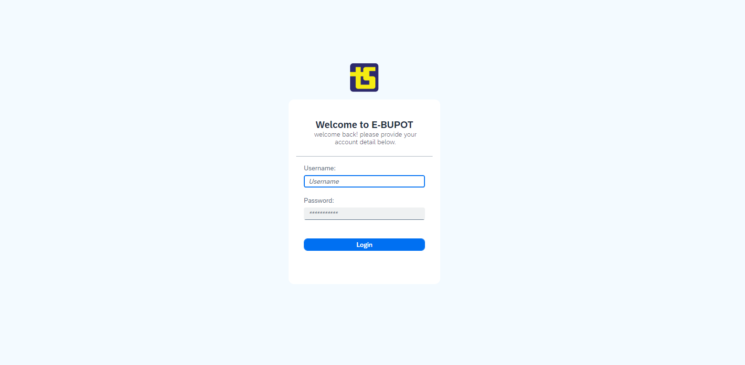
Mock Up
Login Page
Notes:
Kolom vendor di kiri

Slide 12
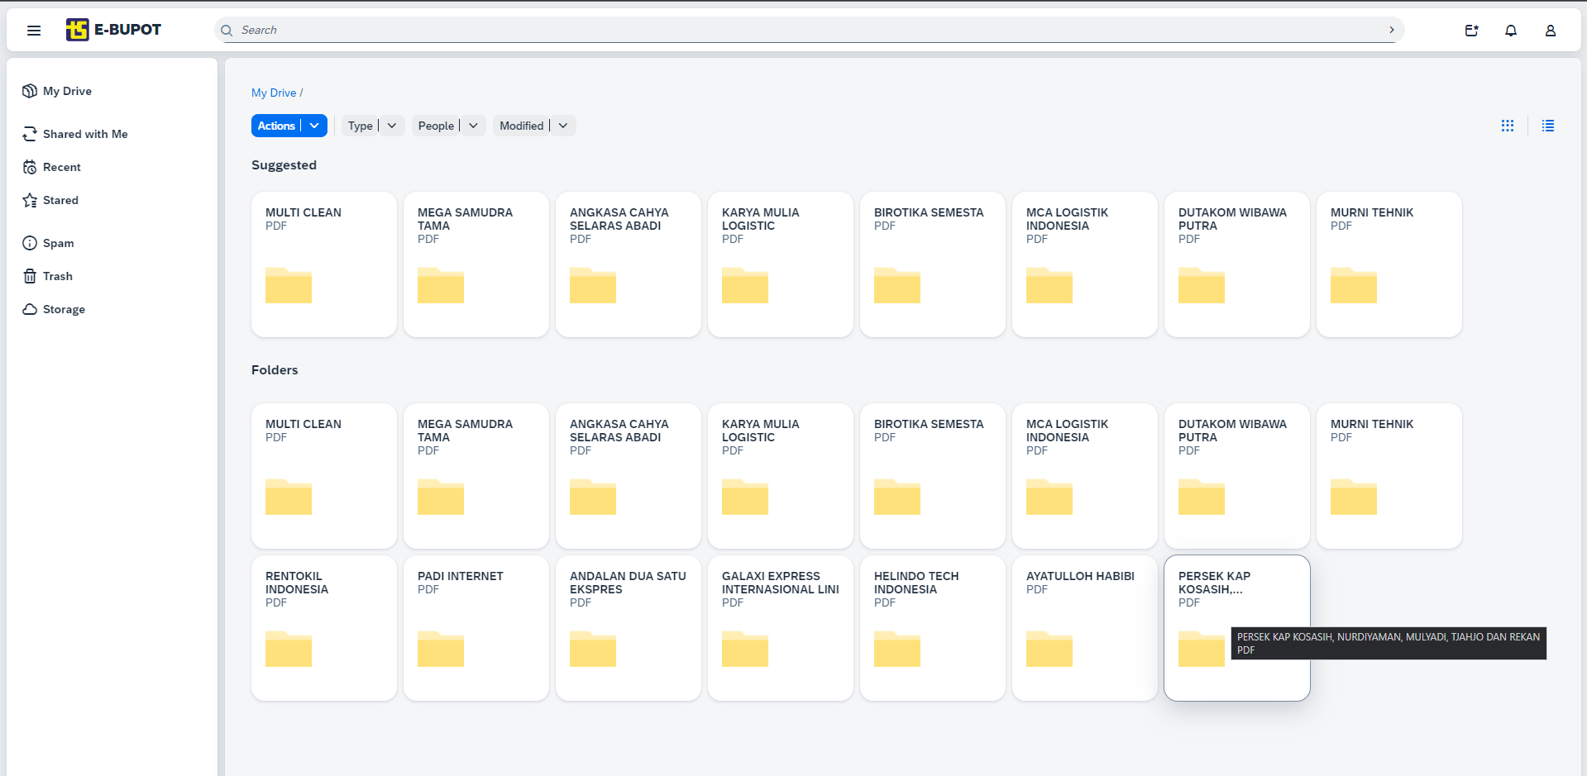
Mock Up
Dashboard
Notes:
Kolom vendor di kiri

Slide 13
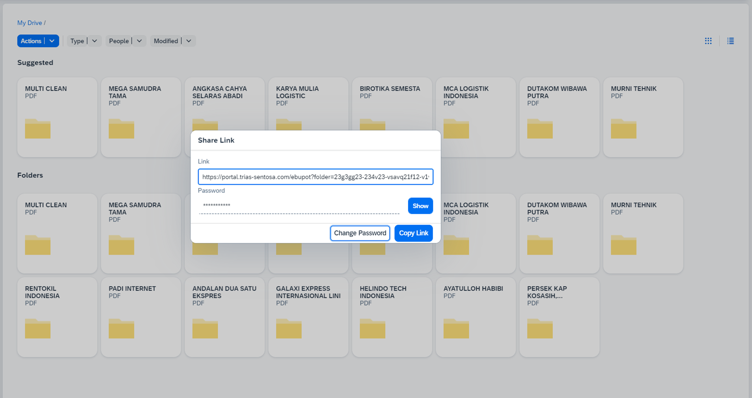
Mock Up
Share Link
1
2
Notes:
Kolom vendor di kiri

Slide 14
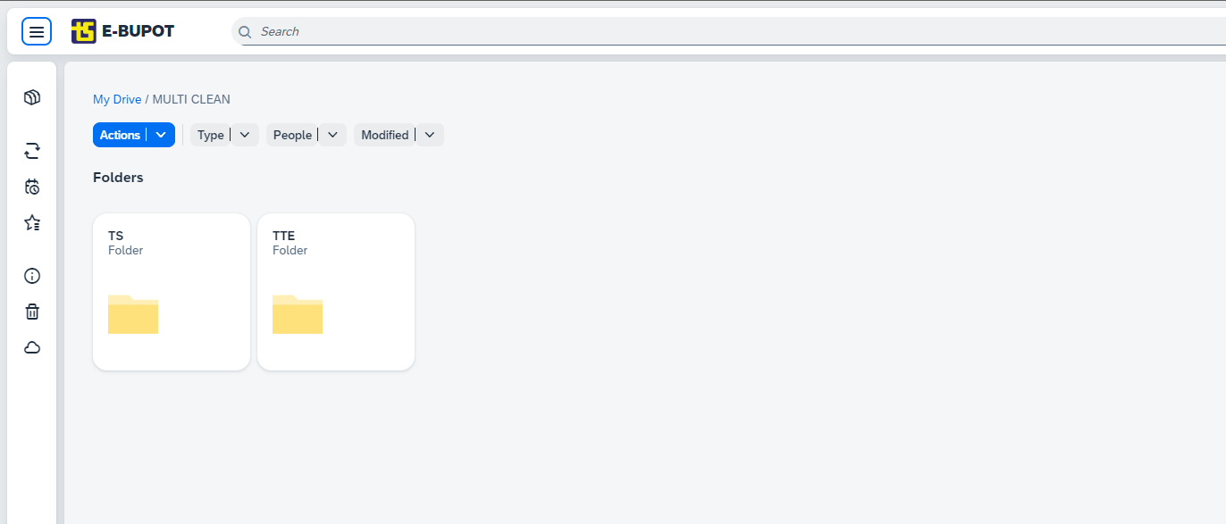
Mock Up
Vendor Company

Slide 15
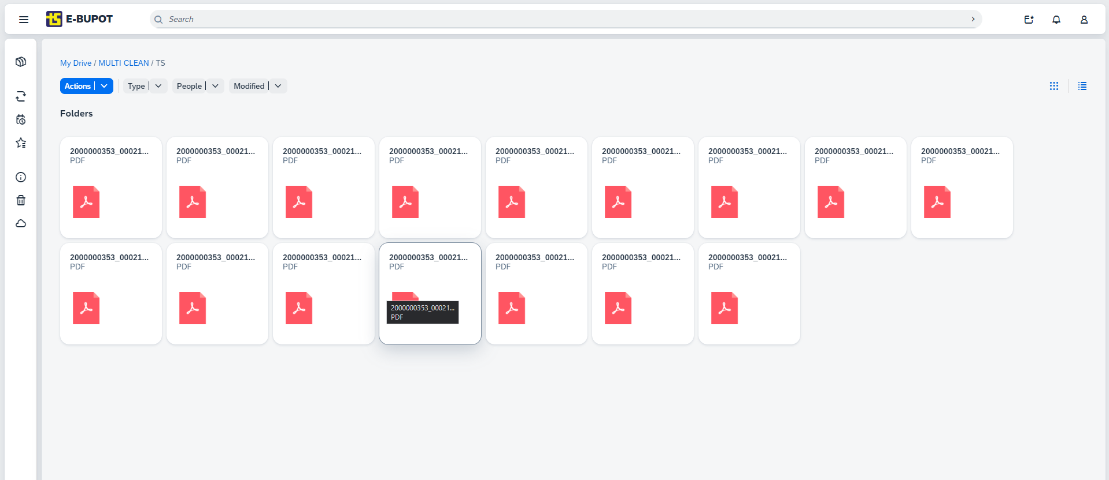
Mock Up
Vendor Page
Notes:
Setelah multi clean, harus nya folder per company dulu, baru di dalam nya ada pdf multi clean

Slide 16
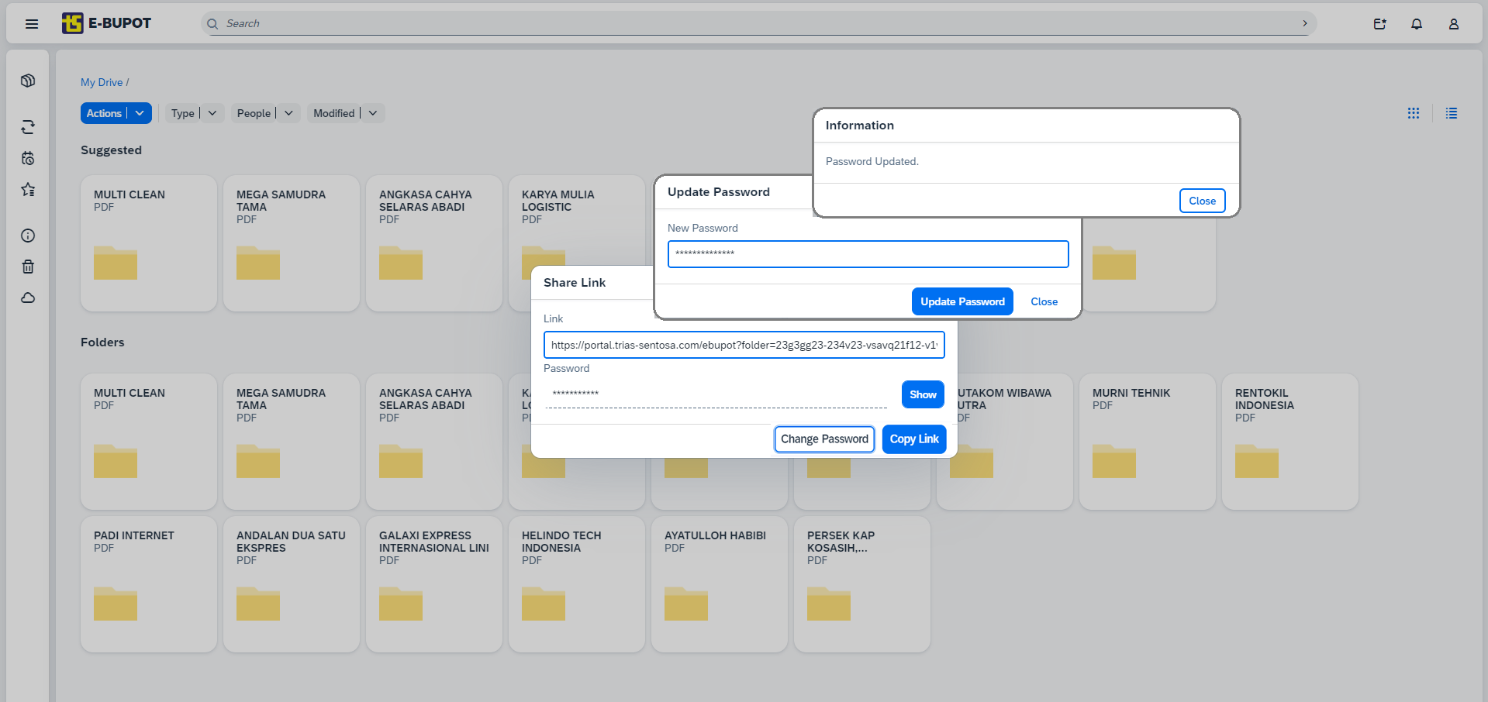
Mock Up
Update Folder Password
4
1
3
2
Notes:
Kolom vendor di kiri

Slide 17
File Distribution Process
Download zip file from DJP Online Website
upload
Website Bukti Potong PPh Vendor
upload
Download zip file from DJP Online Website
File name
Un-ZIP and Create Folder
File name
Vendor A
Vendor B
Vendor C
8296749936030002022110.zip
9096749936030002022110.zip
Digit 1-15 | 829674993603000 | NPWP TTE
Digit 16-21 | 202211 | Year – Month
Shareable link
Shareable link
Shareable link
Digit 1-15 | 909674993603000 | NPWP TS
Digit 16-21 | 202211 | Year – Month
Create Folder
TS
TTE
TS
TTE
TS
TTE
Vendor A
Vendor B
Vendor C
Move file
Vendor A
Vendor B
Vendor C
File PPh 1
File PPh 2
File PPh 3
File PPh 1
File PPh 2
File PPh 3
File PPh 1
File PPh 2
File PPh 3
File PPh 1
File PPh 2
File PPh 3
File PPh 1
File PPh 2
File PPh 3
File PPh 1
File PPh 2
File PPh 3

Slide 18
File Distribution Process
File name
9096749936030002022110.zip
Website for Vendor PPH Deduction Proof
Digit 1-15 | 909674993603000 | NPWP TS
Digit 16-21 | 202211 | Year – Month
Download zip file from DJP Online Website
Un-ZIP and Create Folder
Vendor A
Vendor B
Vendor C
Vendor A
Vendor B
Vendor C
Shareable link
Shareable link
Shareable link
Create Folder
download
upload
TS
TTE
TS
TTE
TS
TTE
File name
Move file
File PPh 1
File PPh 2
File PPh 3
File PPh 1
File PPh 2
File PPh 3
File PPh 1
File PPh 2
File PPh 3
File PPh 1
File PPh 2
File PPh 3
File PPh 1
File PPh 2
File PPh 3
File PPh 1
File PPh 2
File PPh 3
8296749936030002022110.zip
Digit 1-15 | 829674993603000 | NPWP TTE
Digit 16-21 | 202211 | Year – Month
Vendor A
Vendor B
Vendor C

Slide 19
Table of Contents
Project Background and Current Situation
2. Project Objective and Key Result
3. Project Scope
4. Business Process Flow
5. Project Deliverables
6. Project Schedule
7. Project Organization

Slide 20
Project Deliverables
Phase | Activities | Deliverables | Status
PREPARE | Project Initiation | Project Scope & Schedule are Defined | In Progress
 | Discovery and Evaluation | Solutions are Discovered and Evaluated | In Progress
EXPLORE | Business Blueprint Design | Business Blueprint Design is Documented | Planned
 | Business Blueprint Confirmation | Business Blueprint Design is Approved | Planned
 | Enhancement (RICEF) Design | RICEF Design is Documented | Planned
 | Authorization Requirement and Design | Authorization Requirements and Design is Completed and Documented | Planned
REALIZE | Enhancement (RICEF) Development | RICEF Design is Developed | Planned
 | Run Scenario Test and Integration Test | Scenario and Integration Test are executed and Issues are resolved | Planned
 | Prepare UAT and EUT Delivery | User Acceptance Test Material and Documentation are ready | Planned
 |  | End-User Training Material and Documentation are ready | Planned
DEPLOY | User Acceptance Test (UAT) | User Acceptance Test is approved | Planned
 | End-User Training (EUT) | End-Users are trained | Planned
 | Prepare Production Environment | Production System Environment is ready | Planned
RUN | Go Live | Live Production Environment | Planned
 | Support After Go Live | Functional or Technical Issues are Solved | Planned

Slide 21
Table of Contents
Project Background and Current Situation
2. Project Objective and Key Result
3. Project Scope
4. Business Process Flow
5. Project Deliverables
6. Project Schedule
7. Project Organization

Slide 22
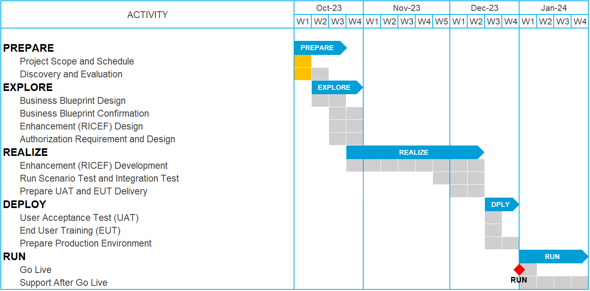
Project Schedule
Legend:
Planned
In Progress
Done
Proposed Milestone
Finished Milestone
Notes:
Kick-off - Dec

Slide 23
Table of Contents
Project Background and Current Situation
2. Project Objective and Key Result
3. Blueprint Confirmation
4. Business Process Flow
5. Project Deliverables
6. Project Schedule
7. Project Organization

Slide 24
Project Organization
Steering Committee
Putu Bagiarsa, Hennie Susanto, Adi Yuda
Business Process Owner
Hennie Susanto
Project Manager
Ryan Haris R
Solution Architects
Adi Yuda, Yunita
Process Expert
Bunga Rizki A, Samuel Gustaf
Consultant
Filla Sartika
Frontend Developer
Dary Saputra A, Oskar Andreas
Backend Developer
M Royyan Z
Notes:
Kick-off - Dec

Slide 25
Thank You

